Slide 1
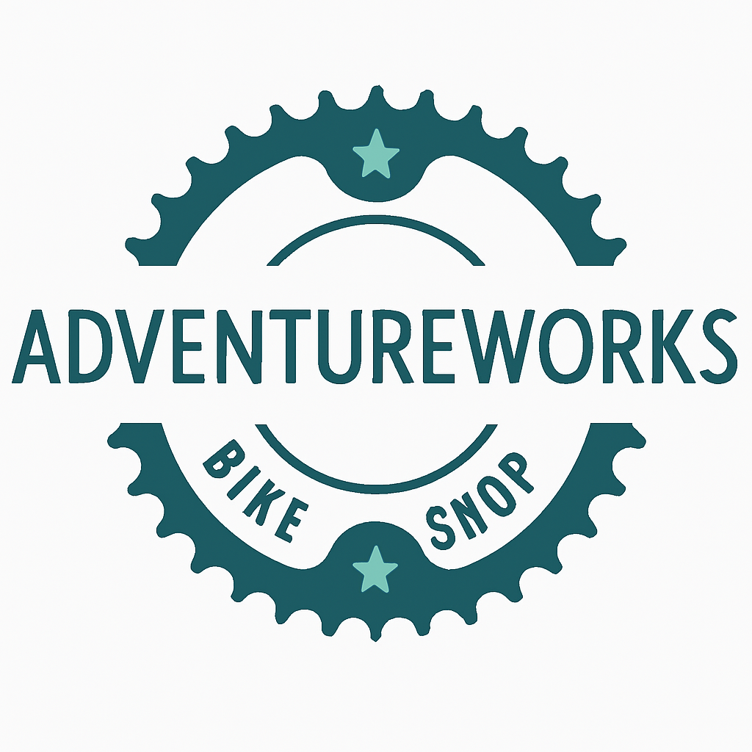
AdventureWorks:
Scaling Smart

Slide 2
AdventureWorks Roadmap Overview
1. Growth
Key metrics and milestones
Regional Performance
Main Initiatives
2. Sales to Revenue
Sales performance trends
3. Assortment
New arrivals and seasonal planning
4. Challenges
Inventory planning
Assortment competition
5. Key Takeaways

Slide 3
AdventureWorks in 2012:
A Stable Foundation
  Total Revenue: $37.68M
  Offline Sales: $30.61M
  Online Sales: $7.06M
Notes:
In 2012, AdventureWorks was operating with a stable revenue base of $37.68M, primarily driven by offline sales and modest online activity.

Slide 4
2013: A Year of Acceleration
Total Revenue: $48.97M → 📈 +30%
Online Sales: $11.86M → 📈 +67.9%
Offline Sales: $37.11M → 📈 +21.3%
Notes:
In 2013, the company grew the operating revenue to total of $48.97M Which is a solid 30% growth.
Online sales surged reaching $11.86M with 67.9% growth
Offline sales scaled up to 37 mil with 21% growth.
We can see that Offline sales still dominate, but the it is 6% lower compared to 2012

Slide 5
Growth Concentration: A Strategic Signal
Regional growth
AU Region: +74%
EU Region: +172%
Combined contribution $9.5M of the $11.3M total growth
Notes:
The company had a strong presence amogs all regions, however two stand out from others -> AU and EU (which consists of GB/FR/DE)
AU reached growth of 74%
EU touched the sky with 172% increase
These two regions combined made 84% of overall growth when we compare 2012 & 2013

Slide 6
Australia Offline Launch (May 2013)
Offline expansion unlocked a new revenue stream, marking a strategic pivot.
Launch date: May 2013
Offline orders: 78
Offline Revenue: $1.8M
3.7% of total revenue
Notes:
Mainly Two things contributed to the overall growth
First one: AU offline channel launch
Might look insignificant?
However it is 3.7% of the total revenue

Slide 7
Online Campaign Impact (May 2013)
The Clothing & Accessories campaign was a turning point — setting the tone for Q3 growth.
Launch date -> May 2013
June Orders: 390 -> 719
November Orders: 383 -> 2103
From double to sextuple in 24 weeks
Notes:
2nd what has happened: Online Campaing launch of Clothing & Accessories categories
It also happened May 2013
In its 1st month it our order count was doubled
In 6 months time the order count was sextupled

Slide 8
Top Products — Dominance & Emerging Potential
Clothing & Accessories: 3% — introduced mid-2013 via online campaign (1.5 mil USD)
This growth came entirely through online channels
They offer cross-sell potential with all bike buyers.
With targeted campaigns, they could grow a lot more from current 3%
Notes:
I would like to ellborate a bit about this campaign
This chart confirms that AdventureWorks is fundamentally a bike company.
It validates where the bulk of investment, inventory, and marketing has gone.
However, this here shows new waters for new business.
Despite launching mid-year, Clothing & Accessories captured 3% of total adventureworks revenue — that’s not trivial.
This growth came entirely through online channels, meaning these categories have :
Low overhead
Fewer fixed costs = more profit per sale.
No need for retail space, staff, or physical inventory handling.
High scalability
You can reach A LOT more customers without increasing costs.
If one campaign works, you can replicate it across geographies or segments instantly
While bikes do remain our revenue engine, the rapid traction of clothing and accessories shows a scalable opportunity

Slide 9
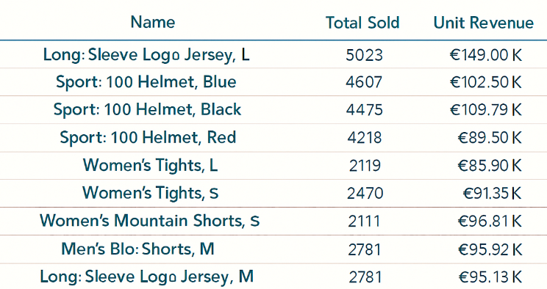
Newcomers Package — Gateway to Brand Loyalty
A curated bundle of top-selling gear for new cyclists:
Can be bought in bundles
Typically carry high margin
Customer likely to restock
Notes:
These products compliment a lot of bike purchases, confirming that Clothing & Accessories as a category is growing
This package isn’t just a sale — it’s the start of a customer journey because It opens doors to future purchases: maintenance kits, performance gear
“The Newcomers Package isn’t just a product bundle — it’s a strategic entry point. These top-ranked items drive upsell can deepen brand engagement, and validate our shift toward scalable, high-margin categories.”

Slide 10
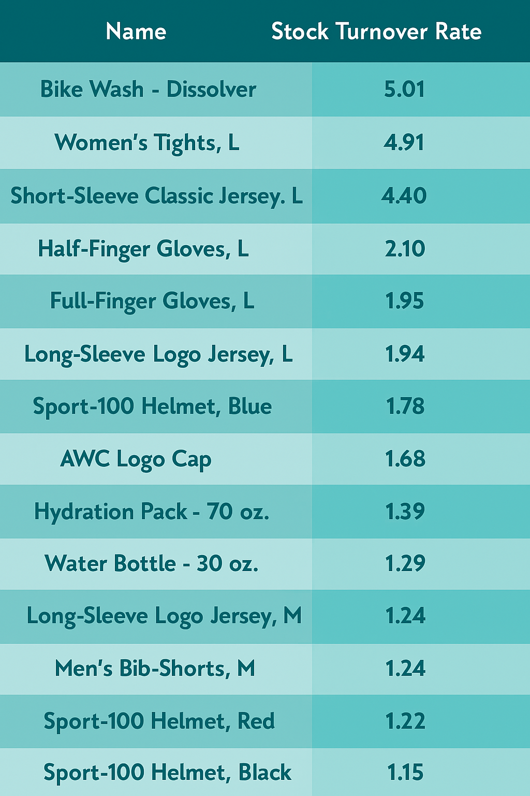
Complication — Growth Meets Inventory Pressure
STR – Stock Turnover Rate
Low STR – overstocking, unpopular product
Hight STR – inventory is selling quickly & efficiency
Notes:
Fast-moving goods are driving growth — but our current inventory cycle can’t keep up
And I want to point out STR.
Basically the index shows how fast or slow inventory is replenished in comparison to sales.
1 = Once per month
Too high STR means inventory is selling too quickly — risking running out of stock
Too low STR may suggest slow sales, or poor inventory management.
As given on the list these top items have STR above 1.
with online purchases that is the main risk , they go out fast and in bundles.
Bulk online shopping amplifies this — demand spikes faster than replenishment.
Our inventory velocity isn’t aligned with seasonal demand. Fast-moving products — especially in summer — are outpacing our restocking rhythm.
To sustain growth, we need smarter forecasting, tighter supply chain , and dynamic inventory strategy

Slide 11
Opportunity — Expand Assortment to Unlock Growth
We offer
Helmets: 3 variants (Black / Blue / Red)
Jerseys: 2 styles ( Long Sleeve / Short Sleeve)
Gloves: 2 types (Full-Finger / Half-Finger)
We are missing
neon, matte, seasonal tones
Aerodynamic, thermal jerseys
Tiered price points (basic vs. premium)
Notes:
“Limited variety in high-demand categories is capping our growth. Strategic assortment expansion can drive incremental revenue.”
High STR + low variety = missed upsell potential
These type of products are like ice-cream -> there is never enough choices
Currently our top categories are under-assorted. By expanding these options, we can capture more demand, increase basket size, and deepen brand loyalty

Slide 12
Key Takeaways
🚴 AdventureWorks is a bike-first brand — but not bike-only
🚀 Clothing & Accessories are emerging stars with digital traction
📊 Online campaigns drive growth efficiently
🔄 Stock turnover insights reveal margin opportunities
🧩 Assortment expansion is a strategic leverage
Notes:
f

Slide 13
Thank you
Q&A

